Slide 1
Unit 3 Algorithmics
Revision Questions 2015-2017

Slide 2
ADTs
Notes:
Start – read the question 2-3 times, answer, then re-read.

Slide 3
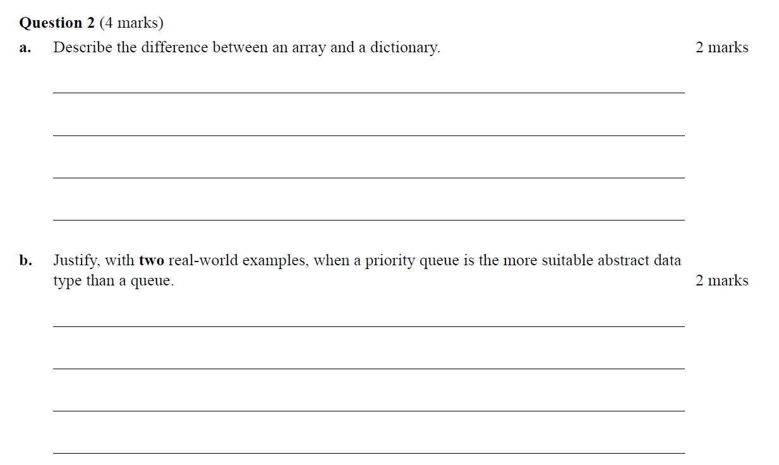
Notes:
2015

Slide 4
An array is fixed length and items are retrieved by an integer indexed. A
dictionary is variable length and items are retrieved by a key element which is
hashed to a particular position.
In a hospital, a queue system would allow patients to be seen in the order they
arrive. A priority queue would allow more urgent patients to be seen ahead of
less urgent patients who arrived before them. Similarly, an email inbox might
show the oldest email received first, but allow priority senders to jump the queue.
Notes:
First one – must be a comparison
Second one – two examples, and the idea that the order of the queue is overridden is important.

Slide 5
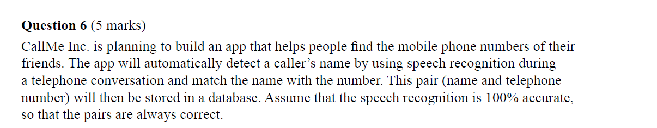
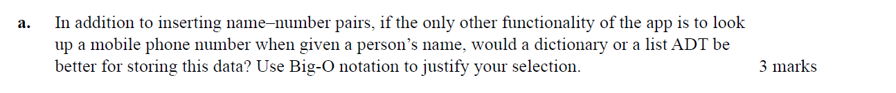
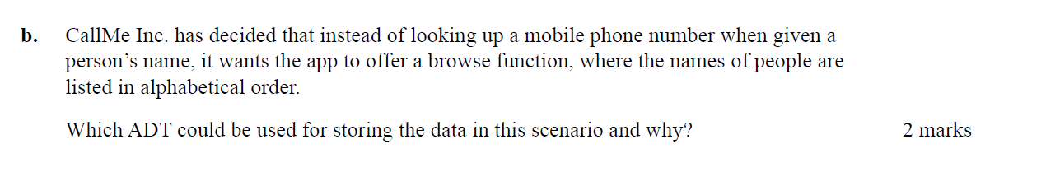
Notes:
2015

Slide 6
List of names could be stored in a list or an array, since these ADTs allow data to be sorted. A dictionary does not support sorting, and is not required here since the question does not say the
number needs to be looked up from the name.
Notes:
2015

Slide 7
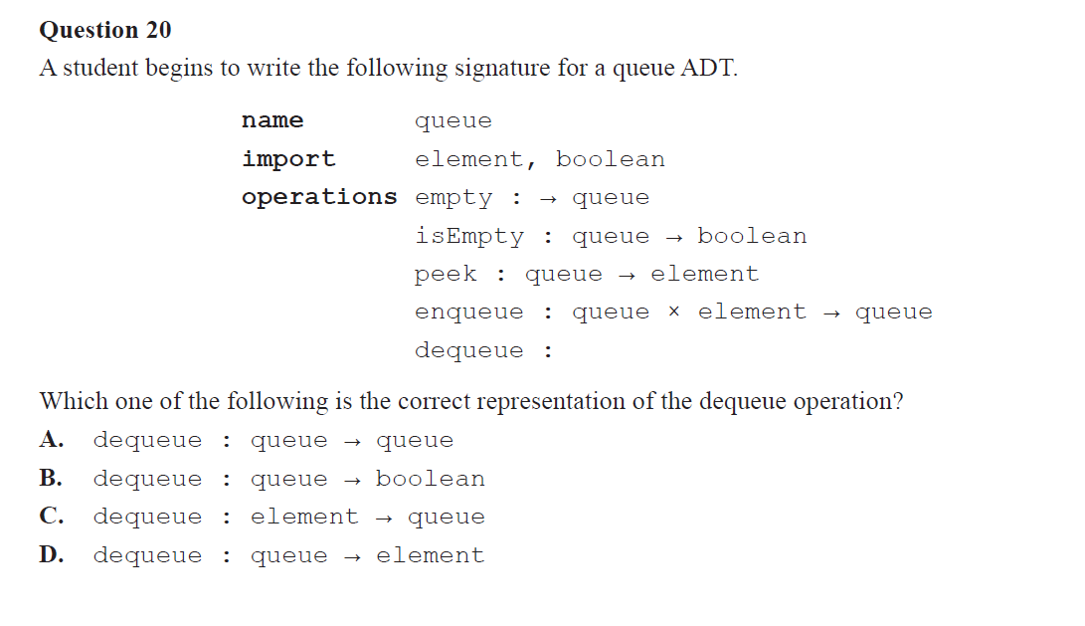
Notes:
2016

Slide 8
Notes:
In Algo, dequeue is not the same as pop i.e. in Python where we return a value at the same time as changing a list.

Slide 9
Graph Algorithms

Slide 10
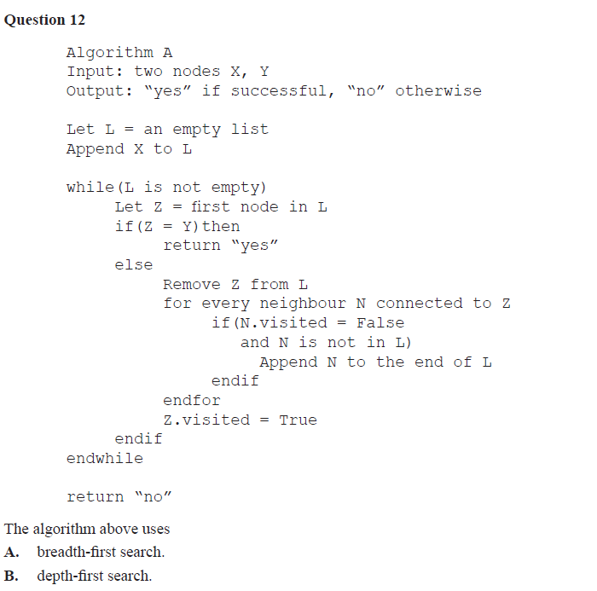
Notes:
2016

Slide 11
Notes:
2016
A

Slide 12
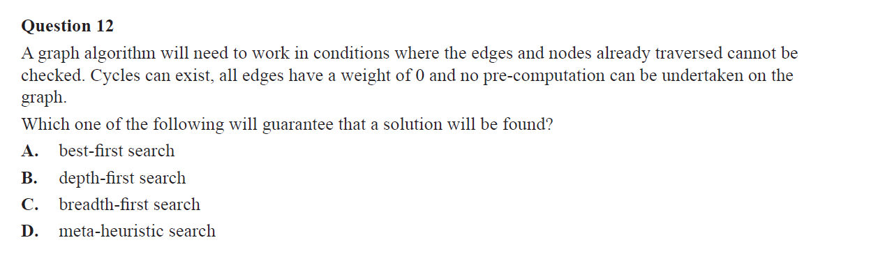
Notes:
2017 C

Slide 13
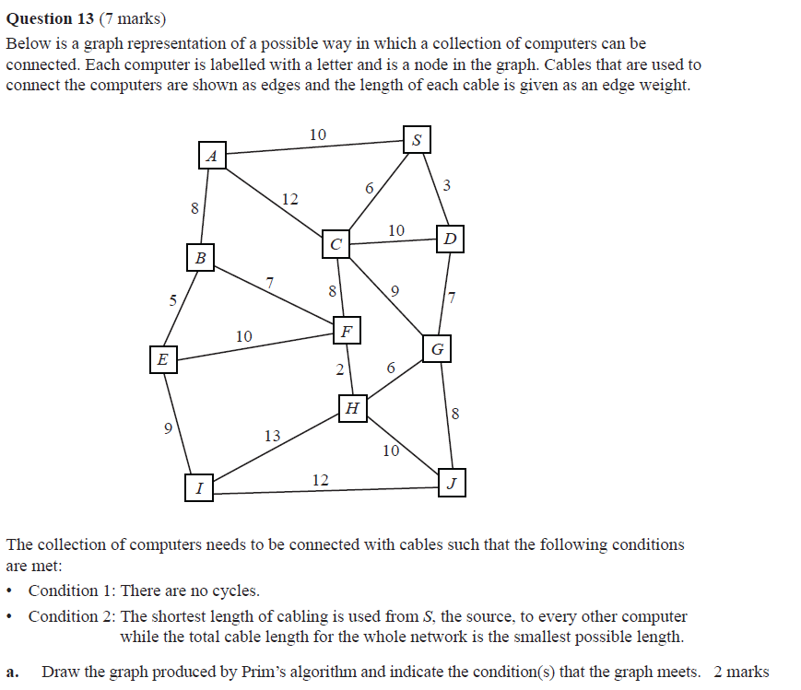
Notes:
2016

Slide 14

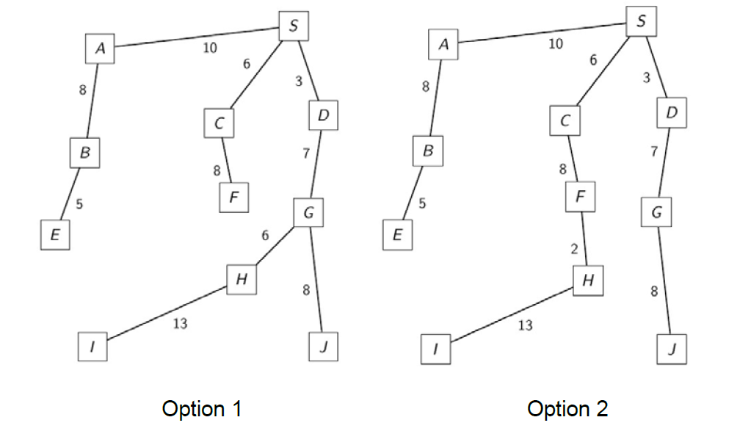
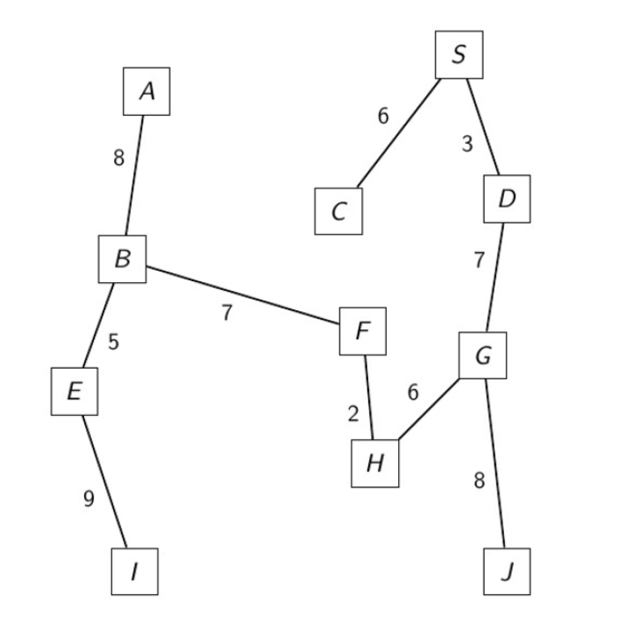
Dijkstra will always produce a graph without cycles. It selects the next node which is nearest to the source. Where there are two possible nodes, select the one with the least weight edge leading to it.
Notes:
2016

Slide 15
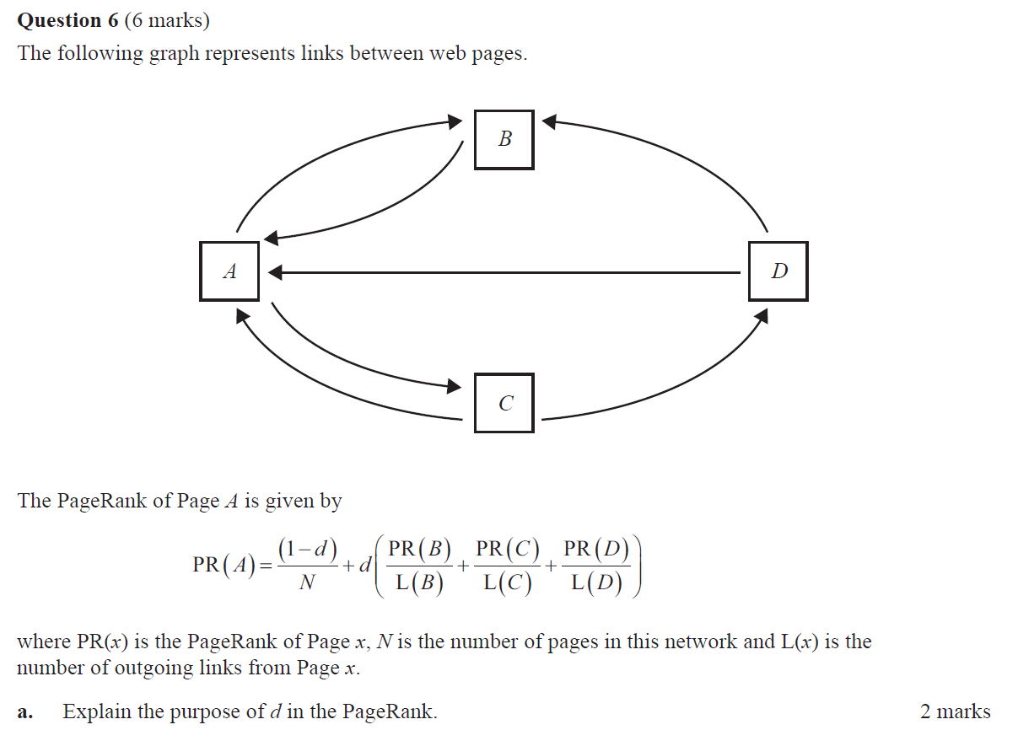
Notes:
2016

Slide 16
d is the damping factor which gives the probability that a random surfer clicks on a link from the page that they are currently on, rather than jumping to a random page.
(1-d)/N represents the probability that a surfer reaches A through random clicking.
The probability that a surfer reaches Page A by clicking a link on another page.
Notes:
2016

Slide 17
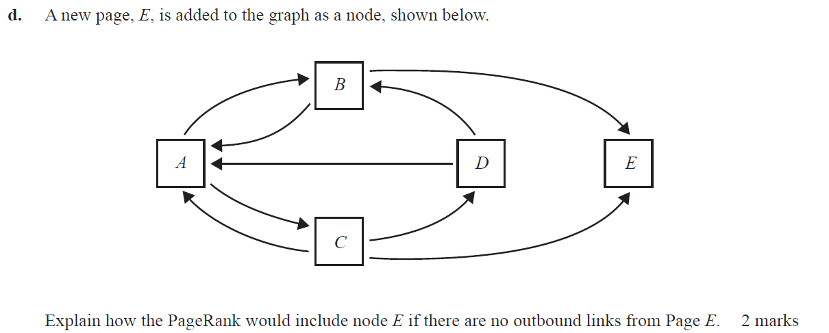
Notes:
2016

Slide 18
d) Because E is a sink node, dummy links are created from E to every other page so there is an equal probability of getting to any given page from E.
Notes:
2016

Slide 19
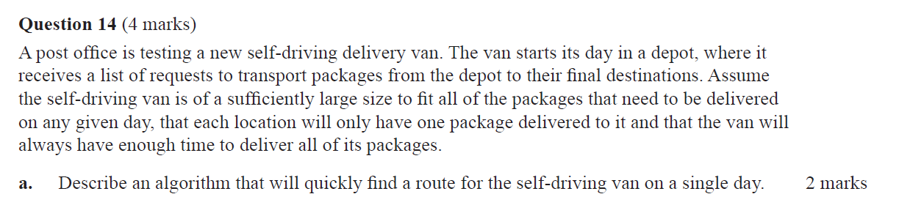
A greedy algorithm could choose the closest unvisited destination at each stage and then return to the depot after all packages have been delivered.
A brute force algorithm could consider all possible paths that deliver the packages and choose the shortest one.
Notes:
2017

Slide 20
Applications

Slide 21
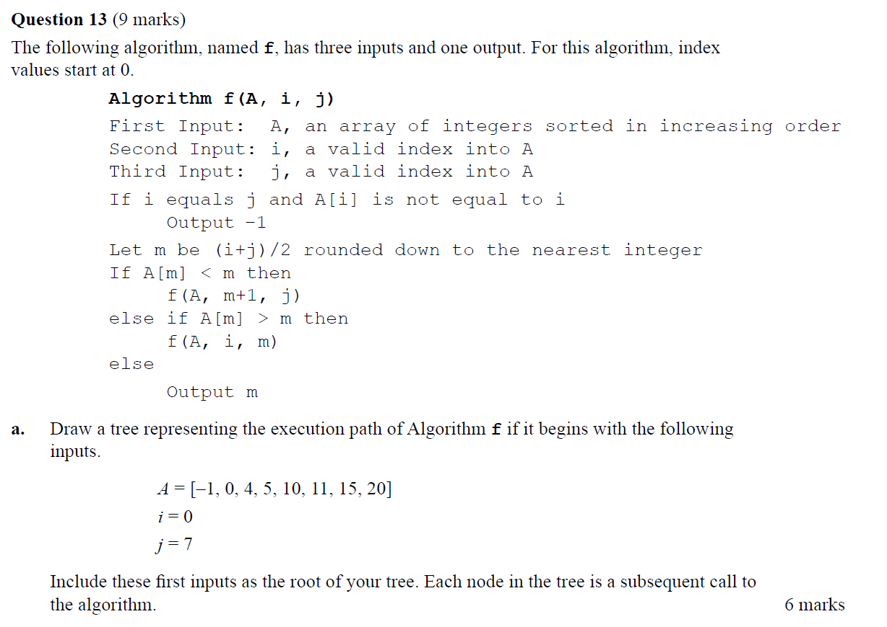
Notes:
2015
(b) i if A[i] = i otherwise -1

Slide 22
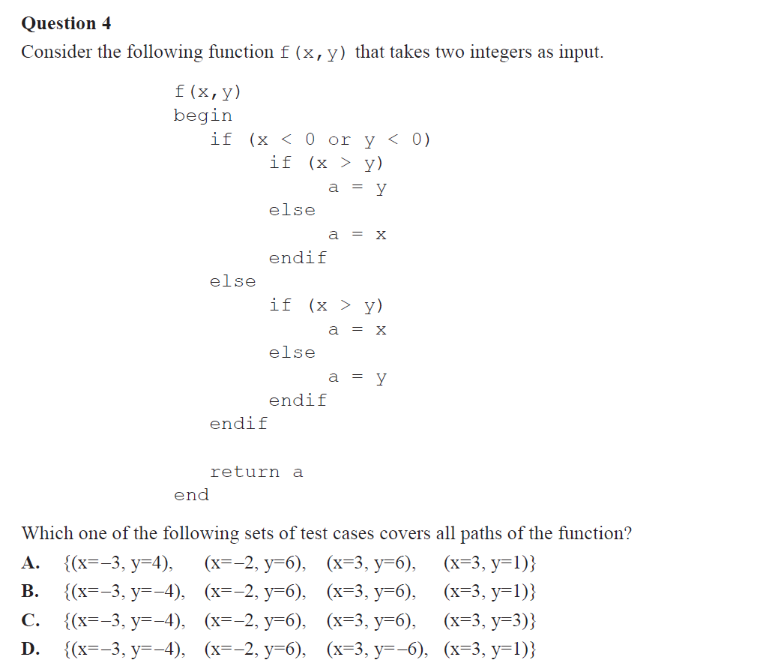
Notes:
2016
B

Slide 23
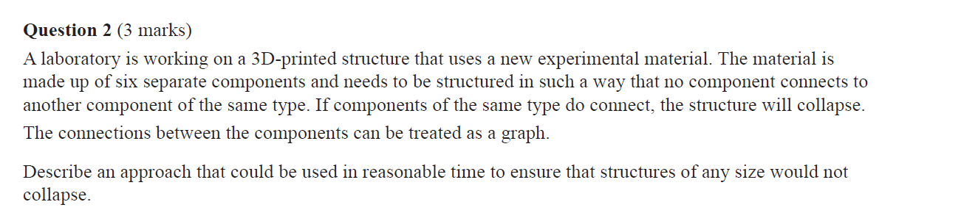
Notes:
2016
Really asking about 6 colours. Also doesn’t say if every component has to be connected.
Could be colouring or verifying.

Slide 24
This problem can be treated as a graph colouring problem with six colours, where each different colour represents a different component type. Each component can be modelled as the node of a graph, with connections between components represented as edges.
Each node would need to be checked in turn to see if it is connected to another node of the same colour. If so then we know that structure would collapse.
OR
Colour the first vertex V #1. For each vertex connected to V, colour it with the lowest numbered colour that has not been used on any adjacent vertices.
Notes:
2016
Really asking about 6 colours. Also doesn’t say if every component has to be connected.
Could be colouring or verifying.

Slide 25
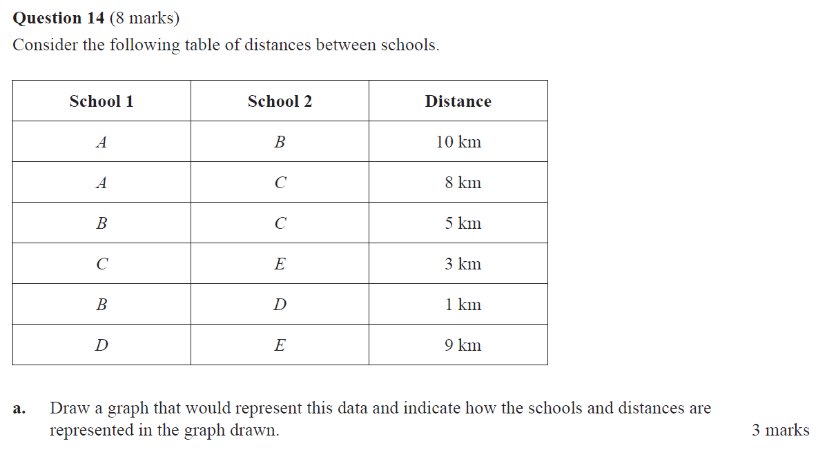
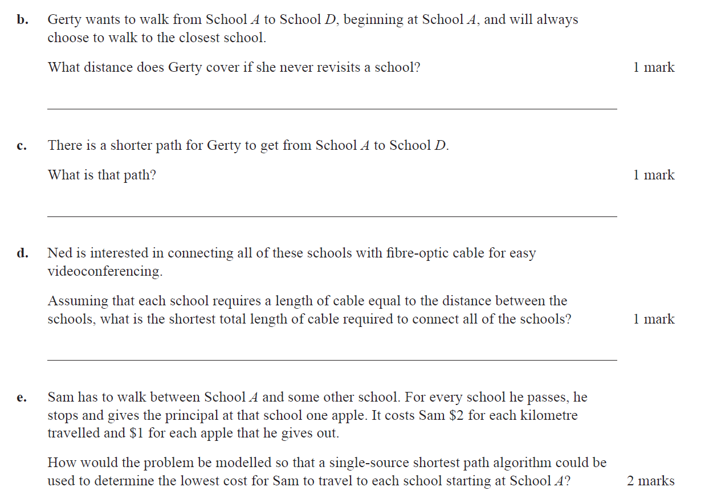
(a) Draw a graph that would represent this data and indicate how the schools and distances are
represented in the graph drawn.
Double edge weights then add one to represent dollar costs.
Then use Dijkstra as normal.
Notes:
2016

Slide 26
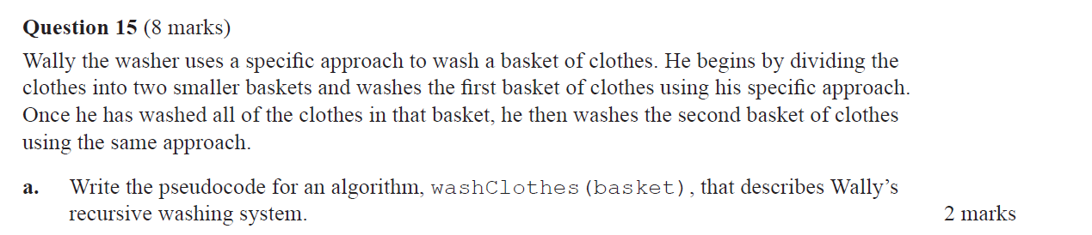
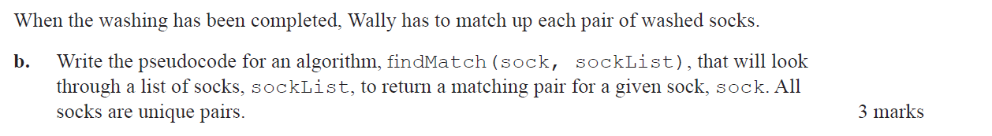
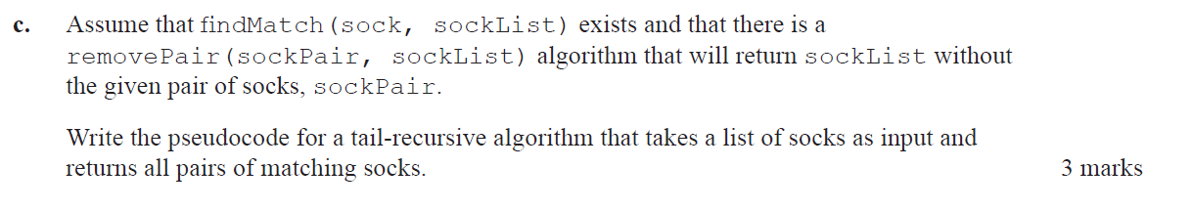
Notes:
2016

Slide 27
(b)
def findMarch(sock, sockList)
for each item in sockList:
if sock is the same pair as item:
return item and sock
return “not found”
(c)
def returnPairs(sockList, pairs):
if sockList is empty:
return pairs
for first sock in sockList:
add findMatch(sock, sockList) to pairs
sockList = removePair(findMatch(sock, sockList), sockList)
return returnPairs(sockList, pairs)
(a)
def washClothes(basket):
if size of basket = 1:
wash that item
else:
washClothes(basket 1st half)
washClothes(basket 2nd half)
Notes:
2016
Recursive algorithm – base case!!!
Also – print is not the same as return

Slide 28
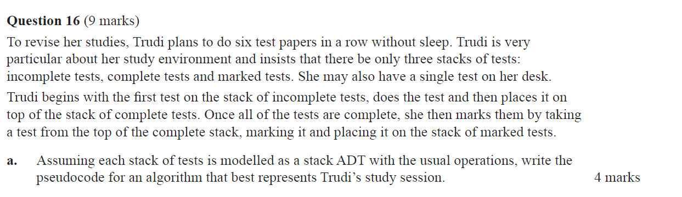
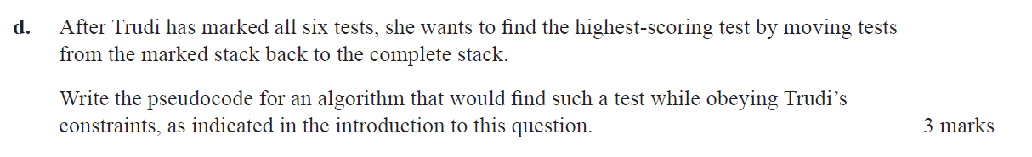
Notes:
2016

Slide 29
a)
repeat until incomplete is empty:
nextpaper = peek(incomplete)
pop(incomplete)
push(nextpaper, desk)
do(nextpaper)
pop(desk)
push(nextpaper,complete)
repeat until complete is empty:
nextpaper = peek(complete)
pop(complete)
push(nextpaper, desk)
mark(nextpaper)
pop(desk)
push(nextpaper,complete)
b) 12
c) 2n
Notes:
2016
a) must use correct operations

Slide 30
d)
paper = peek(marked)
pop(marked)
push(paper,desk)
repeat until marked is empty:
nextpaper = peek(marked)
pop(marked)
current_top = peek(desk)
if score(nextpaper) > score(current_top):
pop(desk)
push(current_top,complete)
push(nextpaper,desk)
else:
push(nextpaper,complete)
Notes:
2016
a) must use correct operations

Slide 31
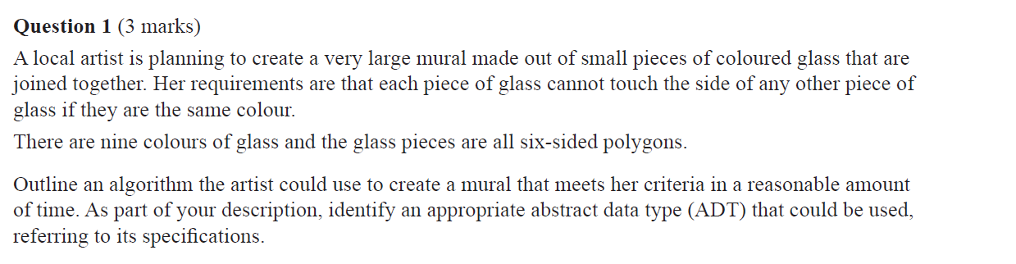
Notes:
2017

Slide 32
Use a graph with nodes representing each piece of glass and edges showing that one piece of glass touches another. Each node will have at most six edges.
Label the colours from 1 to 9.
For the first node, colour it 1.
For each of its neighbours, colour it the smallest number that does has not been used on any adjacent node.
Repeat for each uncoloured neighbour of a coloured node until all nodes are coloured.
Notes:
2017
Language specific to ADT
Remember closing statement

Slide 33
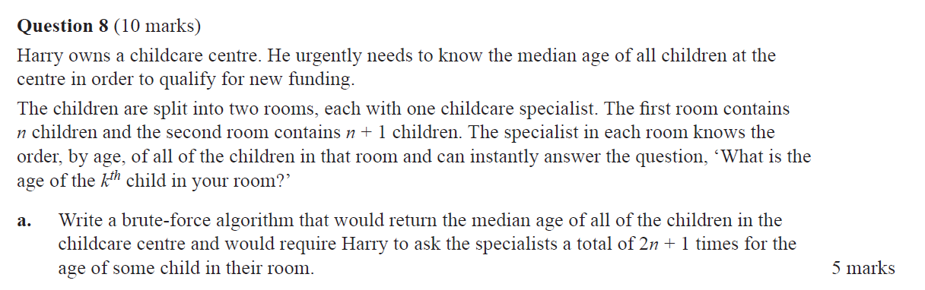
Notes:
2017

Slide 34
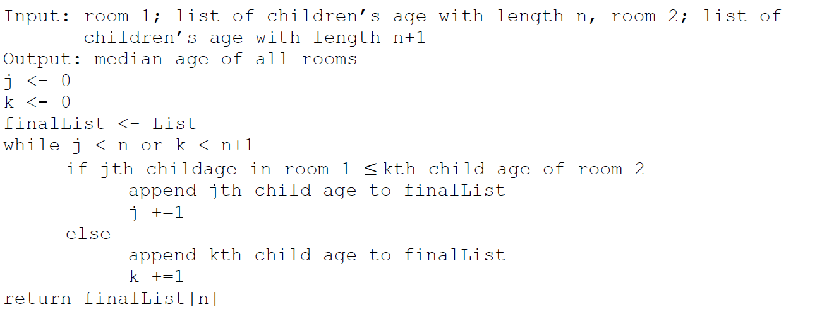
Notes:
2017
Dealing with arrays.
Initialise j and k to 0, position of first item (could do 1)
compare the jth and kth item. Add the smaller one to the final list and move that counter along.
Discussion of where median is
Also ‘or’ could be ‘and’ – once we’ve exhausted one we have passed the midpoint

Slide 35
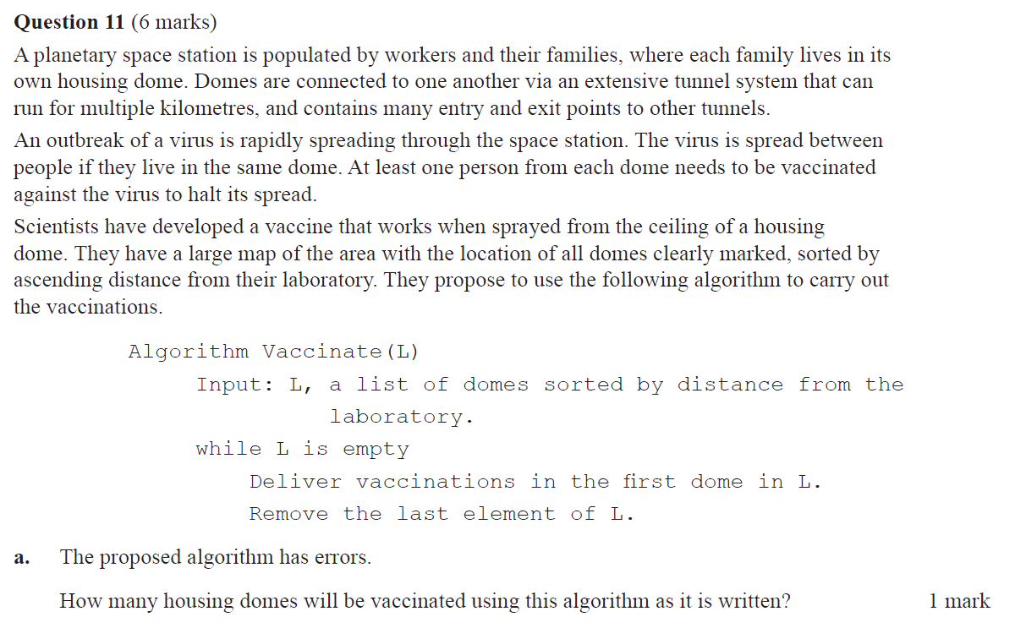
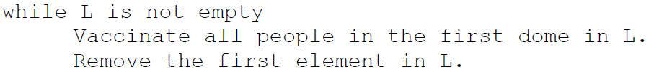
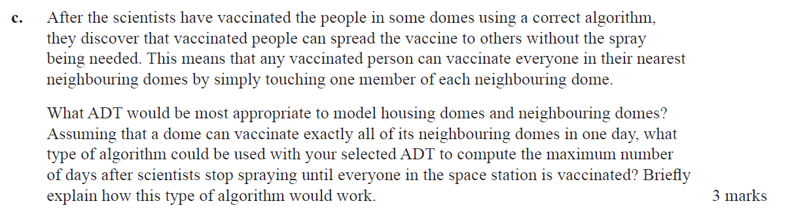
None because L is never empty.
Graph ADT – domes are nodes, edges show which domes are connected.
A breadth-first search could be used. Each level of recursion will represent one more level of depth to the tree, which is one more day of domes vaccinating their neighbours.
Notes:
2017
(b) stick to current style

